Slide 1
Predicting NDIS Funding in Regional South Australia
Presented by:
Myra Villegas - 1834292
Kaplan Business School, Adelaide
Masters of Business Analytics
15 January 2026

Slide 2

Agenda
  What is NDIS?
  Regression Analysis: NDIS Trend Analysis
  Understanding the Business Problem
  Evaluation of Results
  Data Sources & Processing
  Brief Summary of Results
  Data Analytics & Methodology
  Reflection
  Descriptive Analysis: NDIS Participant SA vs VIS
Photo source: https://www.sasi.org.au/navigating-the-ndis-maze-expert-tips-for-maximising-specialist-support-coordination/

Slide 3
What is NDIS?
The National Disability Insurance Scheme (NDIS) is a major national insurance scheme designed to support people with disability to live independently and participate socially and economically (NDIS, n.d.)
Why NDIS is important?
Participant control and independence: Empowers people with disability to choose their supports, providers, and timing, promoting self-determination.
Individualised funding: Provides tailored plans with “reasonable and necessary” supports aligned to personal goals such as education, employment, and daily living.
Social and economic inclusion: Enables greater participation in community life and the workforce through funded supports and access to mainstream services.
Family and carer support: Assists families and carers through respite, counselling, and capacity-building supports.
National system reform: Replaced fragmented state-based services with a consistent, nationwide framework.
Economic benefit: Increases workforce participation and productivity by unlocking the potential of people with disability.
https://www.ndis.gov.au/understanding/what-ndis

Slide 4


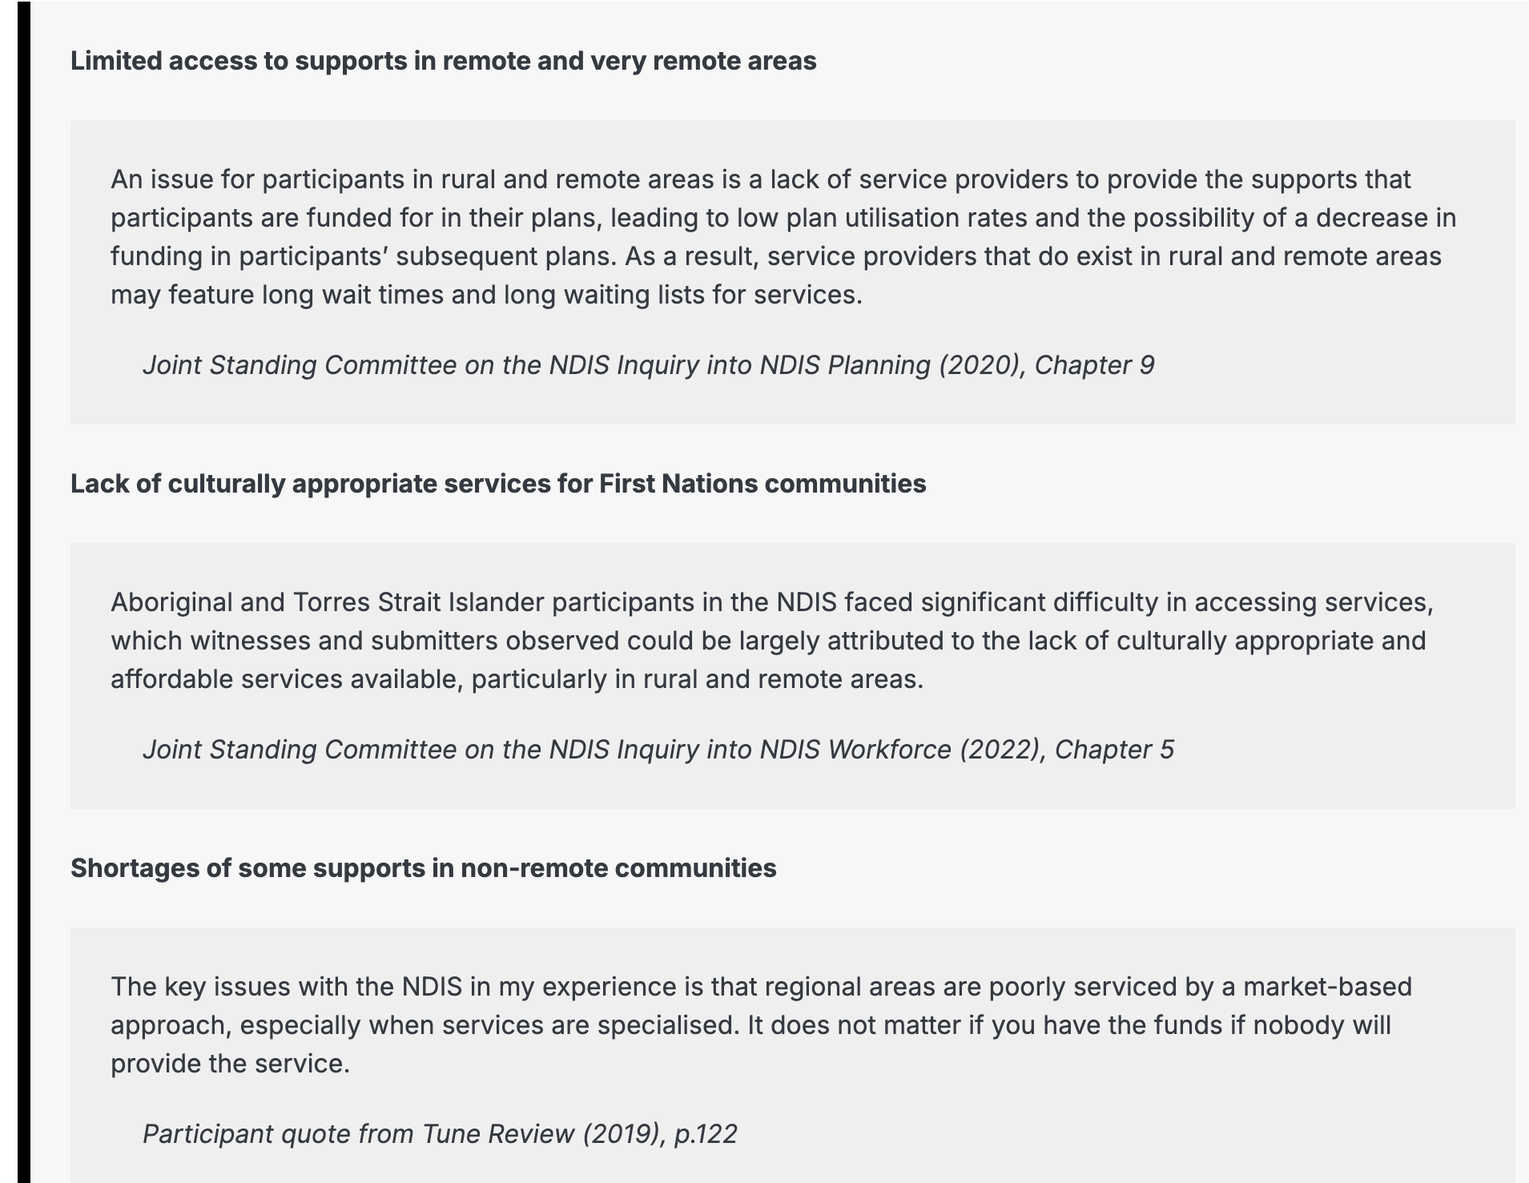
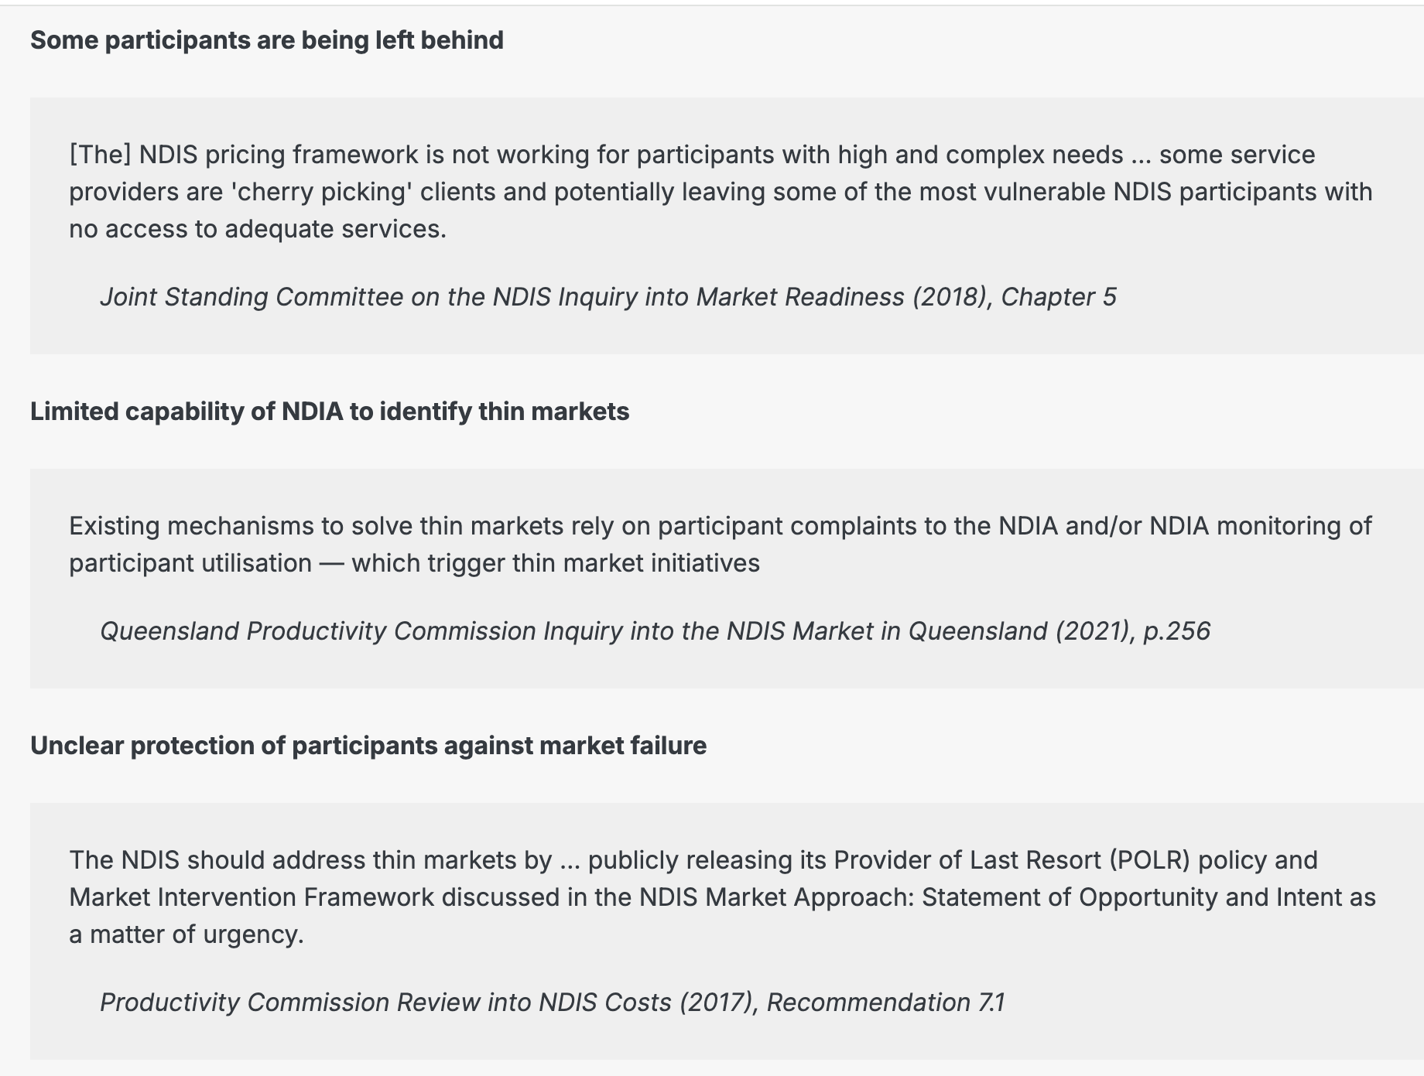
Business Problem
Predict NDIS funding growth in regional South Australia and compare it with regional Victoria.
Source: https://www.ndisreview.gov.au/resources/paper/improving-access-supports-remote-and-first-nations-communities/1-market-challenges

Slide 5
Data Sources & Processing
Processing
Filtered to AgeBnd='ALL' and SuppClass='ALL' to get whole-of-population within each district.
Converted masked counts like “<11” to (1-11) for aggregation (small-number privacy masking).
Estimated total committed budget by summing (participants × average budget) across disability groups (weighted aggregation).
Raw dataset: 65,535 rows | Modelling subset: 10,179 rows
Metro vs Regional definition (operational)
What went to the model?
Input Data
•NDIS Participant Numbers & Plan Budgets (Sep 2025): State, service district, disability group, support class, average annualised committed support budget, active participants.
•Focus states: South Australia (SA) and Victoria (VIC).
Metro districts were defined using capital-city service districts (e.g., Adelaide regions; Melbourne regions). All other service districts were grouped as Regional for this baseline comparison.
Rows used: 10179 (SA+VIC districts × disability groups x age)
Key inputs: active participants, average annualised committed support budget
Outputs: regional vs metro totals
Notes:
references:
file:///Users/myravillegas/Downloads/202012%20NDIS%20Market%20SA.pdf
NDIS dashboard

Slide 6
Data analytics methodology (flow)
Descriptive analytics + time series trend analysis
Acquire Data
2. Clean & Filter
3. Aggregate
4. Compare
5. Forecast
NDIS participant & budget dataset (Sep 2025)
Age=ALL, Support=ALL; handle masked counts (SA & VIC)
Aggregate active participants by district (metro vs regional); budgets used for context only.
Metro vs Regional (SA vs VIC)
5-year scenario growth
Descriptive analytics: metro vs regional comparison of active participants and estimated committed budgets (Sep 2025 baseline).
Regression Analysis: Total NDIS active participants from 2020-2025 to quantify the relationship between time and participant growth.
Outputs are designed for provider workforce planning and policy resource allocation decisions.
5

Slide 7
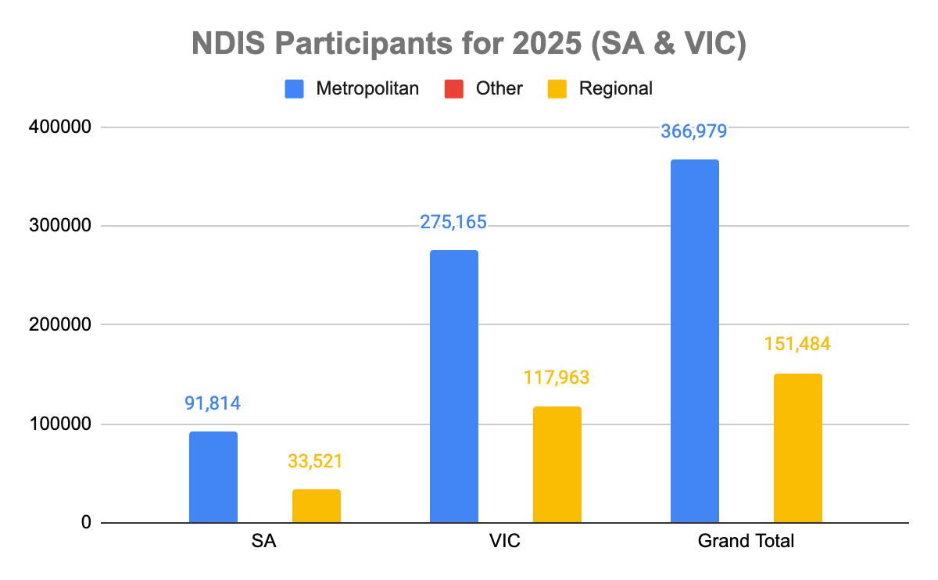
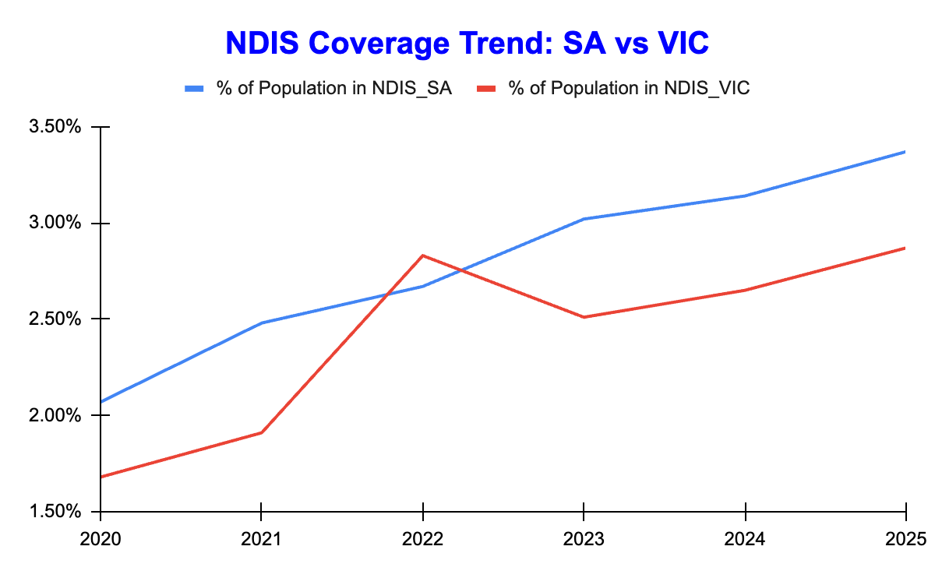
Descriptive Analytics SA vs VIC
Post-cleaning results: Following midpoint estimation to address NDIA-masked small cell values, the distributions reflect adjusted but comparable participant counts rather than exact totals.
Metropolitan dominance remains: In both states, NDIS participation is concentrated in metropolitan areas, consistent with population density and service availability.
Relatively higher regional share in SA: After cleaning, South Australia still shows a higher proportional reliance on regional participants compared with Victoria.
Sustained growth trend: NDIS coverage has increased steadily in both states from 2020–2025, with South Australia maintaining a higher participation rate relative to population.
Planning implication: The adjusted results reinforce the need for regional service planning in South Australia to ensure equitable access following continued participant growth.

Slide 8
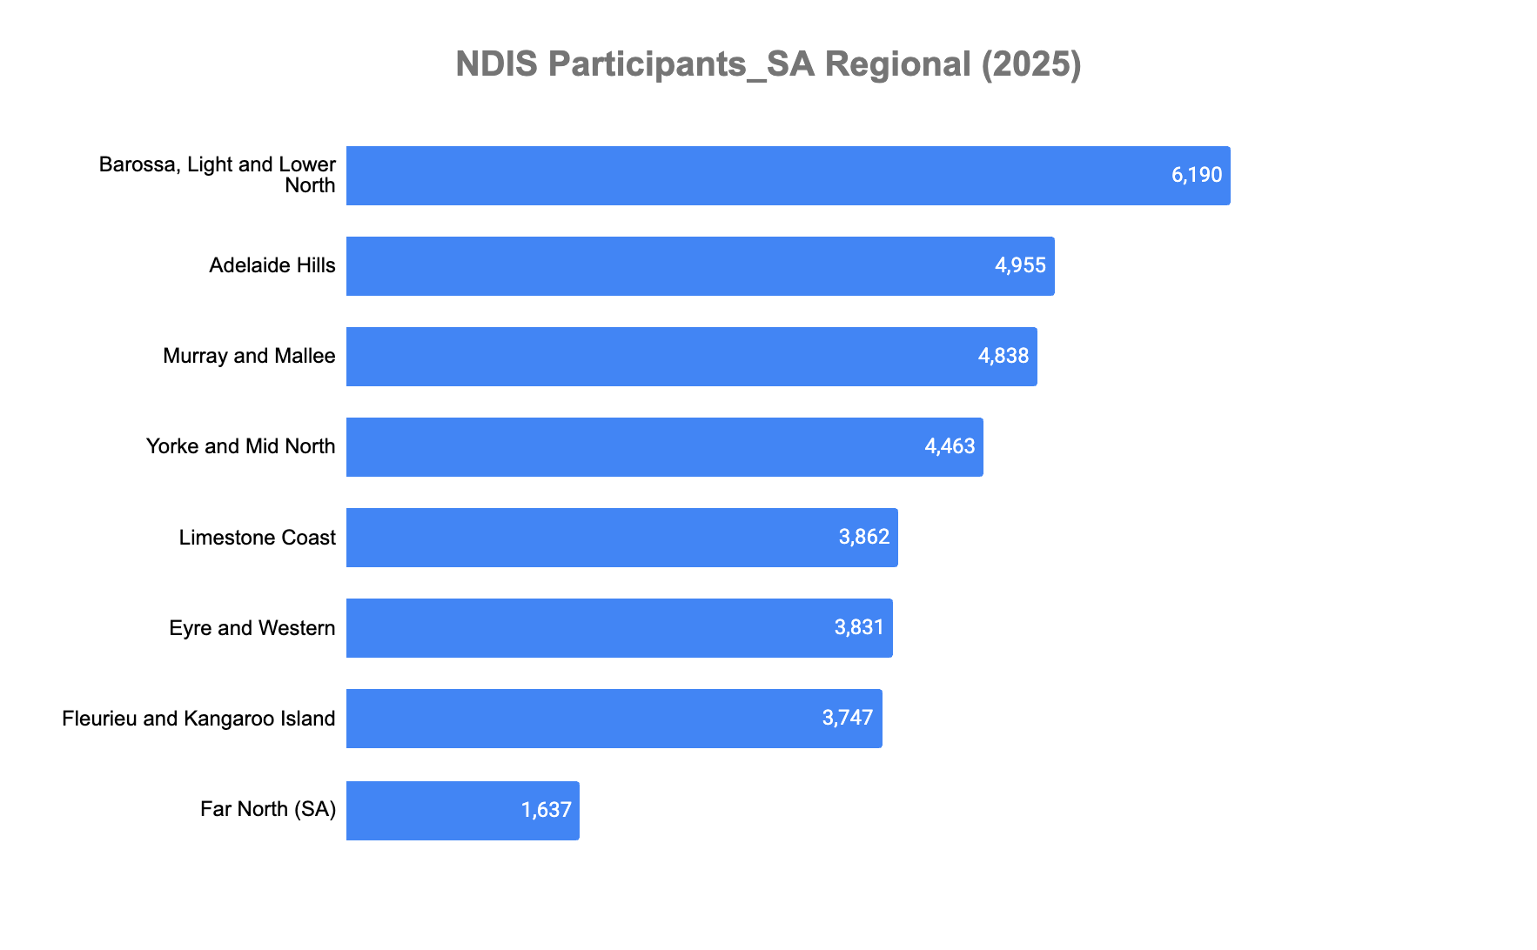
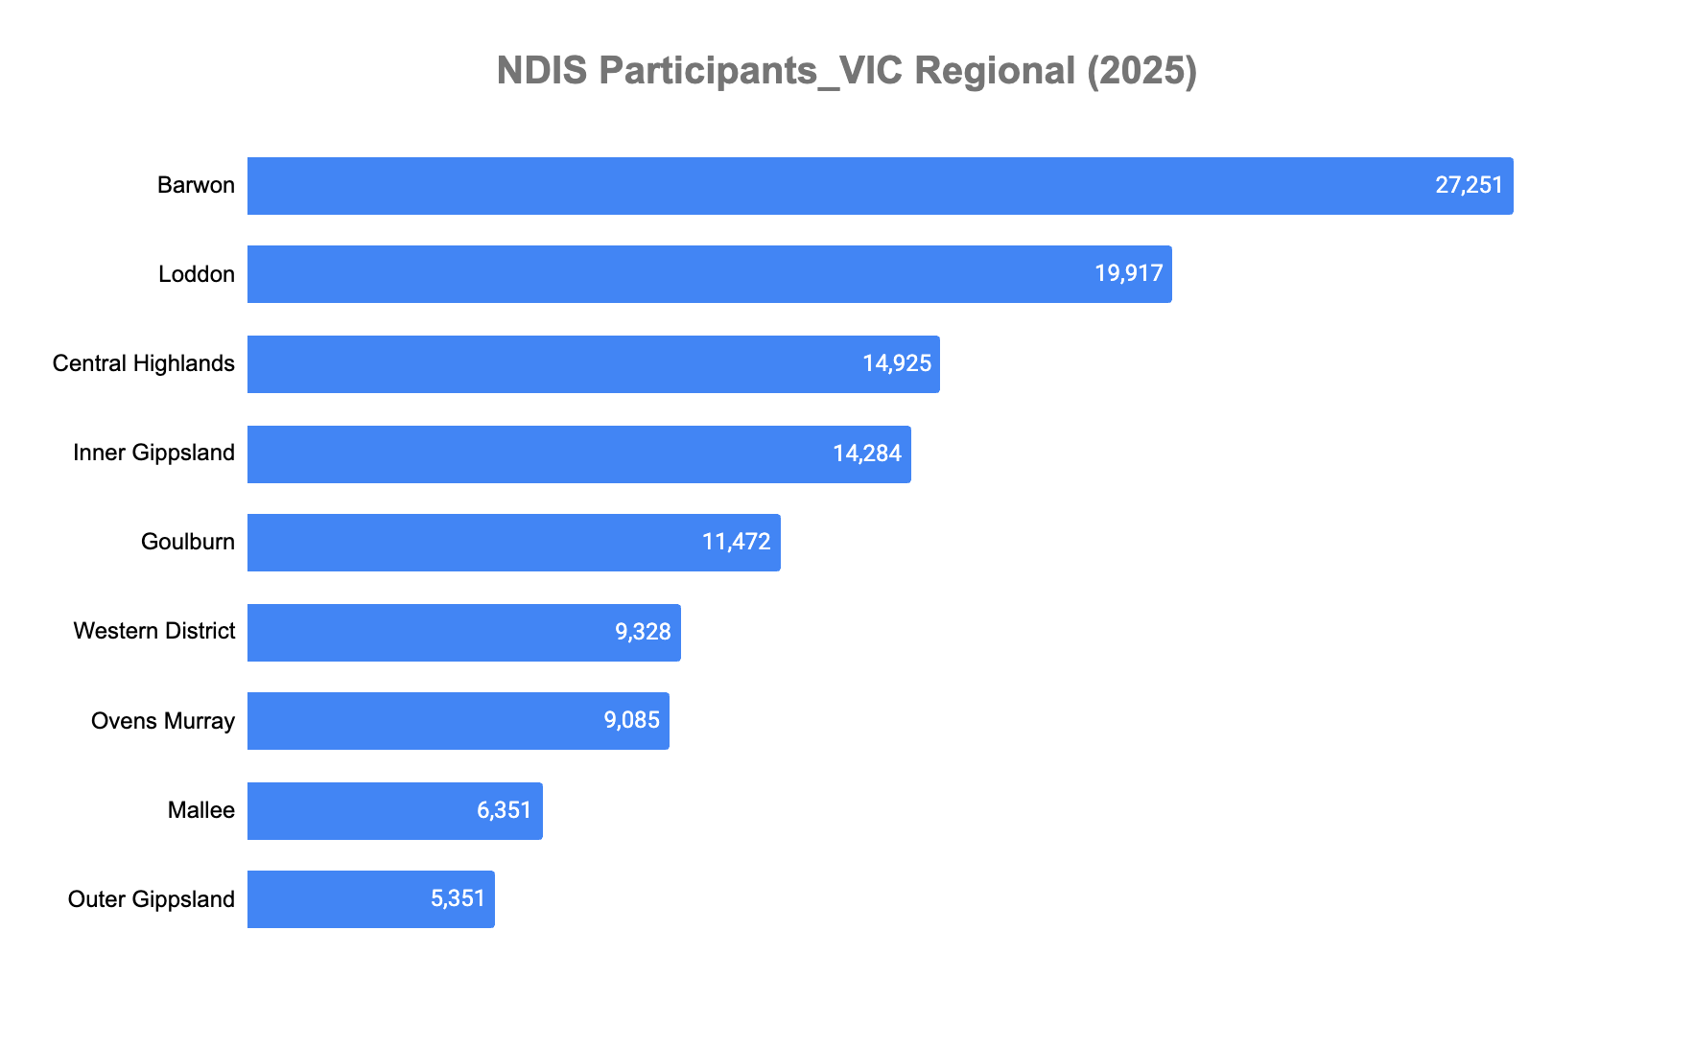
Descriptive Analytics - Suburb (SA vs VIC)
SA regional context: After midpoint cleaning of masked NDIA values, South Australia shows a dispersed regional NDIS participant base, with smaller counts spread across multiple districts, increasing service delivery and workforce complexity.
Participant relevance: Geographic dispersion increases the risk of uneven access, longer wait times, and service gaps for participants in outer regional areas.
Policy relevance: Comparing SA against VIC highlights structural differences rather than funding priority, helping identify where SA’s regional areas may face higher access risks despite lower absolute numbers.
Service provider relevance: Lower volumes per region affect provider sustainability, workforce allocation, and travel costs, requiring providers to operate across wider catchments to remain viable.
Government relevance: Understanding regional dispersion supports informed workforce planning, service commissioning, and infrastructure decisions, ensuring policy responses reflect service delivery complexity rather than total participant counts.
Analytical value: Descriptive analysis at the regional level reveals structural service challenges that are not visible in state-level totals, informing downstream forecasting and planning decisions.

Slide 9
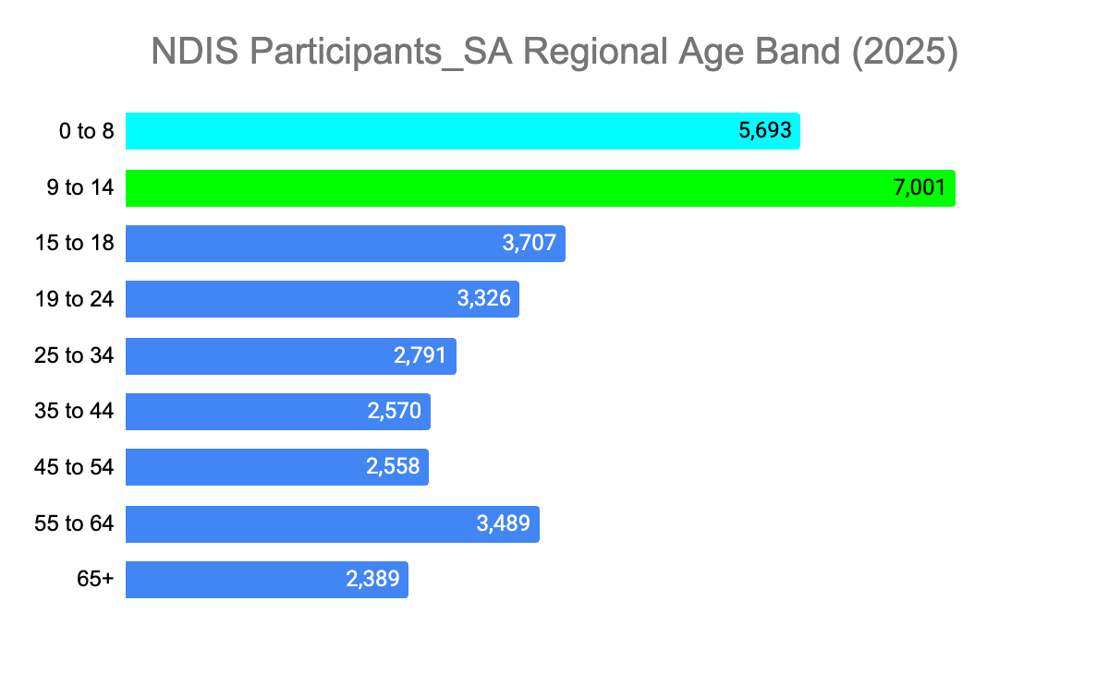
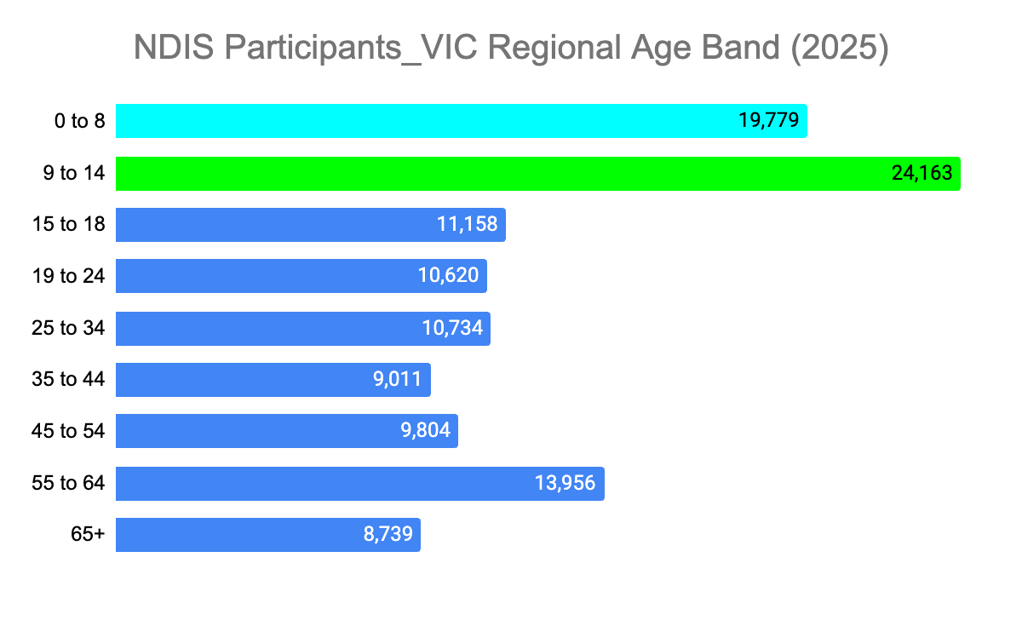
Descriptive Analytics - Age Band (SA vs VIC)
Early-life demand concentration: In regional SA, the largest participant groups are aged 0–8 and 9–14, indicating sustained demand for early-intervention, therapy, and family-based services outside metropolitan areas.
Workforce planning risk: Regional SA has smaller absolute numbers across adult age bands compared to VIC, but service needs remain equally complex, requiring providers to maintain broad skill coverage despite lower economies of scale.
Benchmarking value of VIC: VIC’s larger and more evenly distributed age-band volumes provide a benchmark for mature service ecosystems, highlighting where SA may face higher delivery pressure per participant.
Service continuity: The age-band spread suggests participants will transition through multiple life stages within regional systems, reinforcing the need for long-term service availability rather than short-term or metro-dependent provision.
Equity implication: Lower participant density in SA regions does not reduce service obligation; providers must ensure consistent access and quality across all age groups to prevent regional disadvantage.

Slide 10
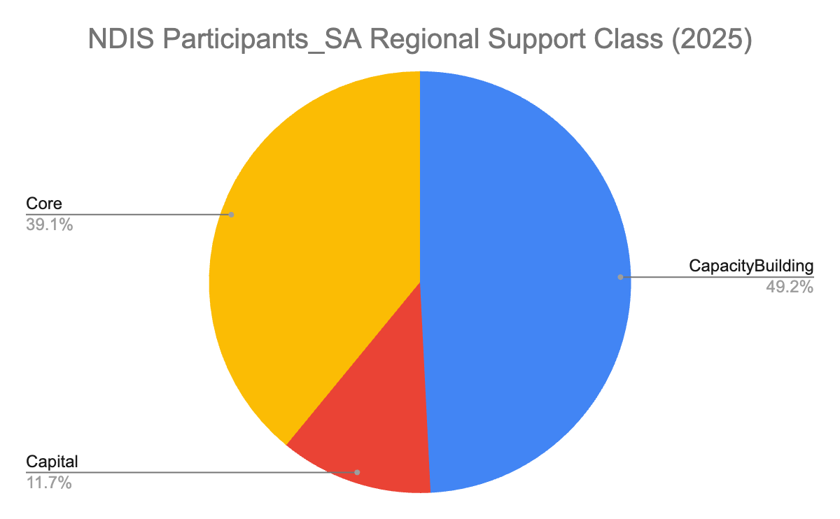
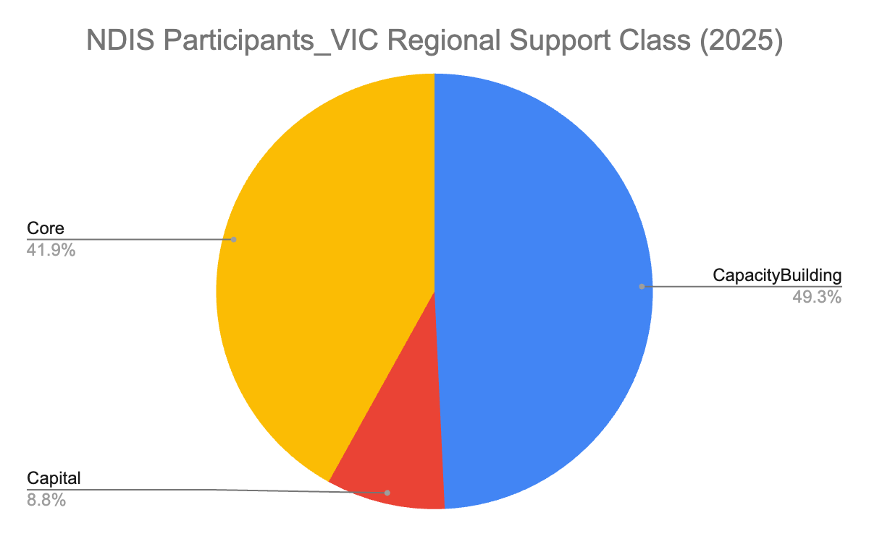
Descriptive Analytics - Support (SA vs VIC)
Support profile: Demand is dominated by Capacity Building, followed by Core, indicating ongoing, service-intensive participant needs.
Participants: High Capacity Building share implies longer-term engagement and reliance on consistent service access.
Service providers: Requires a stable, skilled workforce and sustained service availability, not episodic delivery.
Government: Support mix informs funding design, workforce planning, and market sustainability, beyond simple participant counts.

Slide 11
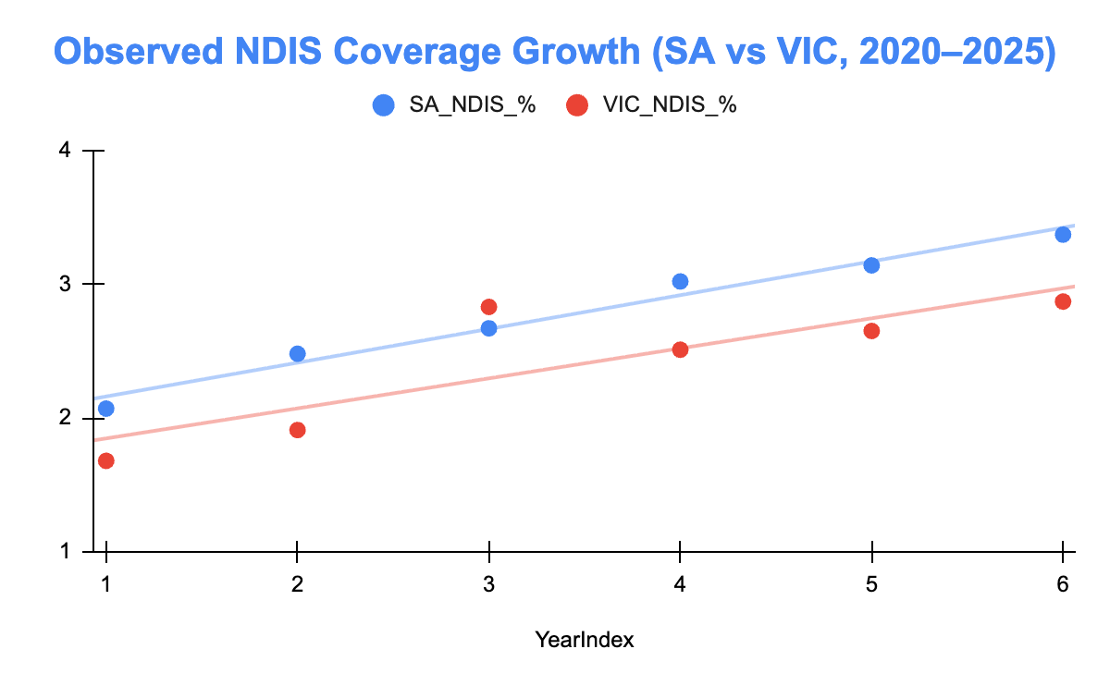
Regression Analysis
Positive time effect: The upward slope of both regression lines indicates that NDIS coverage has increased steadily over time in both South Australia and Victoria.
State effect (SA > VIC): The consistently higher SA regression line shows that, controlling for time, South Australia has a higher NDIS participation rate than Victoria.
Growth differential: The steeper slope for SA suggests a faster rate of increase in NDIS coverage relative to Victoria, indicating stronger structural or regional demand drivers.
Notes:
Use state-level NDIS growth trends to project regional participants forward, holding the regional share constant.
This is called a top-down allocation forecast. It is widely used in policy planning.

Slide 12
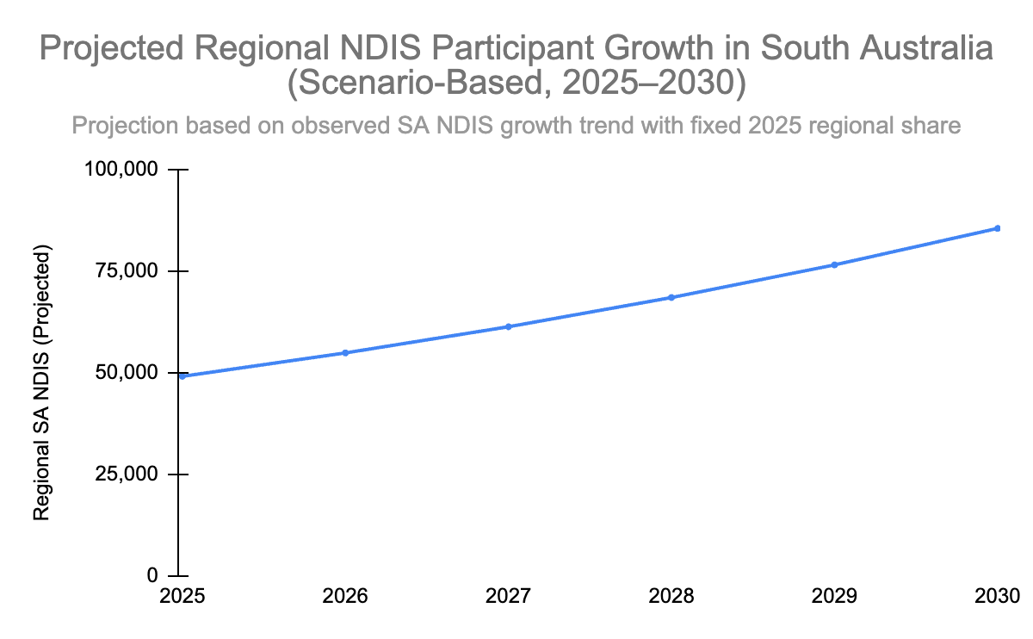
Regression Analysis
Scenario-based projection derived from regression-informed total growth
Demand signal: The upward trajectory indicates sustained growth in regional SA NDIS participants, implying increasing pressure on local service capacity.
Service planning: Providers must scale workforce, travel coverage, and service mix ahead of demand to avoid access delays in regional areas.
Participant impact: Without proactive expansion, growing participant numbers risk longer wait times and reduced service continuity.
Policy relevance: The projection supports early infrastructure and funding planning to maintain equitable access as demand rises.
Participant counts are estimated due to NDIA disclosure controls for small cells; results reflect comparative trends and distributions rather than exact reconciled totals.
Because regional population data were unavailable, regional NDIS growth was projected by applying the observed 2025 regional share to total SA NDIS projections, allowing examination of future service demand while maintaining equity and avoiding location-based prioritisation bias.
Projection: The regression equation (Projected Total = Intercept + Slope × YearIndex) was used to estimate total SA NDIS participants for 2026–2030.
Regional estimate: Projected regional SA participants were derived by applying the fixed 2025 regional share to each projected SA total.

Slide 13
Evaluation of Results
Accuracy, relevance to business problem, and improvement pathway
What the analysis reliably shows | How the analysis could be strengthened
Internal coherence: Aggregated metro and regional participant estimates reconcile closely with published state-level totals after midpoint treatment of masked values, supporting consistency of the cleaned dataset. Structural validity: Regional areas exhibit lower participant density and greater geographic dispersion, aligning with known NDIS thin-market characteristics. Trend credibility: Observed and projected growth patterns are consistent with documented NDIS expansion between 2020–2025, indicating plausible forward trajectories. Business relevance: Results directly address the service-planning problem by identifying where sustained regional demand may strain provider availability. | Richer time series: Incorporate quarterly NDIA participant data to enable more robust forecasting (e.g., ETS or ARIMA models). Population context: Integrate ABS regional population and socioeconomic data to support per-capita and equity-based comparisons. Service utilisation: Add payments-versus-budget data to assess under-utilisation and unmet service demand. Finer geography: Use SA3/SA4-level breakdowns where available to reduce aggregation bias and better reflect thin-market realities.

Slide 14
Evaluation of Results
Business relevance, limitations, and decision context
Business Significance | Key limitations (current scope)
Establishes a clear snapshot of regional NDIS demand and funding pressure using a consistent September 2025 baseline. Identifies where regional growth is most likely to strain provider capacity, directly informing workforce and service planning. Surfaces thin-market risk in regional South Australia, where lower participant density increases service access vulnerability. Provides evidence to support targeted, region-specific policy and commissioning decisions, rather than uniform state-wide responses. | Based on a single-period baseline, limiting formal predictive accuracy and confidence intervals. Broad metro vs regional groupings may mask variation within inner regional, outer regional, and remote areas. Uses aggregated participant counts, which do not reflect individual funding intensity or support complexity. Privacy masking of small cells introduces minor aggregation error despite midpoint adjustment.

Slide 15
Brief Summary of Results
Interpretation and evaluation of analytical outputs
Interpretation of key descriptive results (Sep 2025 baseline)
The analysis interprets regional NDIS participation in South Australia as lower in absolute terms than Victoria, reflecting population scale rather than reduced service need. Aggregated funding estimates indicate lower total regional budgets in South Australia, constraining provider scale and market depth. Regression-informed projections suggest sustained growth in regional participant demand under a base-case scenario.
Evaluation in relation to the business problem
The results evaluate South Australia as facing a higher risk of thin markets, where smaller participant volumes reduce service viability despite comparable need. Lower regional budgets per participant highlight potential access and service continuity constraints relative to metropolitan areas. Scenario projections demonstrate the importance of anticipatory workforce and provider capacity planning rather than reactive intervention.
Justification of analytical relevance
These findings justify the use of descriptive and scenario-based analytics to inform equitable service planning across geographic regions. The analysis supports evidence-based decision-making for providers and government by identifying where future service gaps are most likely to emerge. Overall, the results justify targeted policy and market-shaping responses to ensure participant access regardless of location.

Slide 16
Reflection: Tools, Techniques, and Peer Review
Evaluation of tools and methods
Excel and Power BI were effective for cleaning, aggregating, and analysing privacy-masked NDIS data at scale.
Visual analytics improved interpretation, enabling clear communication of regional service pressures to non-technical stakeholders.
Regression-informed, scenario-based forecasting was justified and appropriate given limited historical regional time-series data.
Limitations and improvement
Aggregated data limits evaluation of individual funding intensity and service complexity.
Reliance on a single baseline snapshot constraints forecast accuracy.
Peer review reflection
Peer discussion refined the business problem, particularly the identification of thin markets in regional areas.
Feedback strengthened justification of assumptions, limitations, and validation checks, improving analytical credibility and alignment with objectives.

Slide 17
Thank you!

